Slide 1
TBW Presentation
The Relationship Between Stress and Smoking: A Longitudinal Study on Coping Mechanisms

Slide 2
Agenda
01. Introduction and Objectives
02. Conclusion
By Hira Toheed Butt
By Abdullah Saeed
03. Methodology
04. Data Analysis
05. Discussions
By Affan Bin Faisal
By Muhammed Salman Ahmed and Raja Muhammed Fawad Khan
By Izzah Aslam

Slide 3

Introduction
Hira Toheed Butt

Slide 4

Introduction
The Stress Landscape: Beyond Mental Strain to Health Impacts
Pervasive nature of stress in today's world.
Highlight that stress extends beyond mental strain to impact health.

Slide 5
Introduction
Coping Strategies and Health Impact:
Significant negative impacts on health.
Smoking as a noteworthy coping method that warrants attention.

Slide 6
Introduction
Study Purpose:
Main objective of the study: to explore the intricate relationship between stress and smoking.
why people turn to smoking as a means of solace.

Slide 7
Introduction
Changing Nature of Stress:
Stress is not just a psychological phenomenon; it's a real factor influencing decisions and behavior.
Complexity of daily stresses, arising from job demands, relationships, and societal expectations.

Slide 8
Introduction
Decoding Stress and Smoking: Why Choose It, Despite the Risks
Why do people start smoking when stressed?
smoking being a popular choice despite known health risks.

Slide 9
Introduction
What Lies Ahead: Exploring Stress and Smoking Patterns in Depth

Slide 10
Objectives
Stress & Smoking Correlation
Factors Behind Smoker Stress
Exploring Coping Alternatives

Slide 11
Methodology
Affan Bin Faisal

Slide 12

Exploring the Relationship Between Stress and Smoking

Slide 13

Data Collection Methods
Semi-structured interviews (qualitative data)
Google Forms surveys (qualitative and quantitative)

Slide 14

Data Analysis Methods
Thematic Analysis : Figuring out themes and patterns in stories (for qualitative data)
Stats Magic: Using numbers to see trends (for quantitative data)

Slide 15

Tools
Surveys: Google Forms for easy data collection

Slide 16

Rationale
Understand how people cope with stress through smoking
Help with better stress management and quitting smoking

Slide 17

Data Analysis 1
Muhammed Salman Ahmed

Slide 18
Overview of Data Analysis
Mix of qualitative and quantitative data.
Goal: Uncover patterns in the stress-smoking relationship.

Slide 19
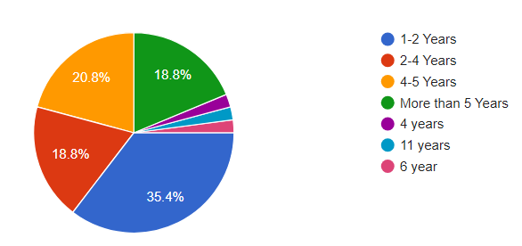
Smoking Habits: Smoking Duration & Coping
Participants reported varied smoking durations.
Insights into coping mechanisms related to stress over different time frames.
Valuable for understanding temporal aspects of the stress-smoking relationship.

Slide 20
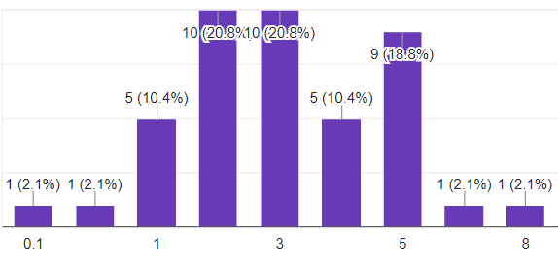
Smoking Habits: Daily Smoking Intensity
Responses spanned a spectrum of daily cigarette counts (1-8).
Quantitative data on the intensity of smoking behaviors.
Foundation for exploring correlations with stress levels and coping strategies.

Slide 21
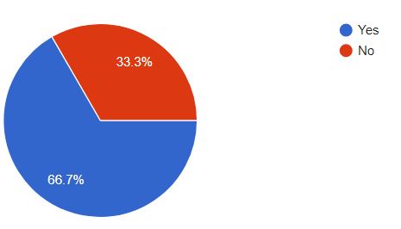
Smoking Havits: Quitting Attempts & Interest
Majority affirming previous efforts to quit smoking (66.7%).
Varied spectrum of interest in quitting (14.7% Very Interested, 68.7% in the middle).
Foundation for exploring relationships between past quit attempts, stress levels, and coping mechanisms.

Slide 22
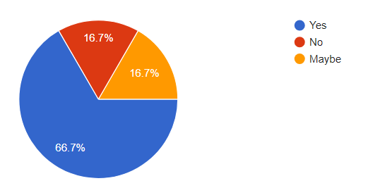
Coping Mechanisms
Majority acknowledging smoking more when stressed (66.7% Yes).
Array of coping mechanisms, with smoking as a predominant choice (90%).

Slide 23
Data Analysis 2
Raja Muhammed Fawad Khan

Slide 24
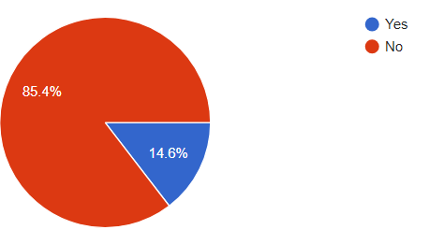
Psychological Factors
Mental Health Conditions:
22.9% diagnosed with mental health conditions.
Understanding the potential intersection with smoking behaviors.
Mental Health Treatment:
Majority (85.4%) not receiving current mental health treatment.
Opportunity to explore barriers to access or preferences for coping strategies.

Slide 25
Psychological Factors
Self-Perceived Stress Levels:
Varied self-reported stress levels (8.3% Very Low, 35.4% Very High).
Contextualizing the broader stress landscape within the study population.
Primary Sources of Stress:
Diverse stressors: academic pressures, personal relationships, financial concerns, work-related stress.
Need for targeted interventions addressing specific stressors for personalized stress management.

Slide 26
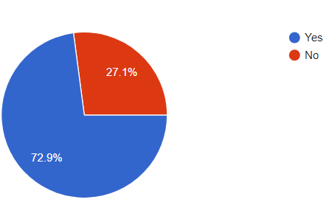
Social and Environmental Factors
Varying levels of ease in accessing cigarettes (37.5% Very Easy).
Perceived influence of friends and family on smoking habits (31.3% Extremely).
Majority indicating personal or social issues influencing smoking (72.9% Yes).
Acknowledging the complexity and evolving nature of the stress-smoking relationship.

Slide 27
Discussions
Izzah Aslam

Slide 28
Discussions
Investigating the Link between Stress and Smoking Habits Over Time
Explore the duration of participants' smoking habits, ranging from 1-2 years to over 11 years.
Identify patterns indicating how stress influences the frequency and intensity of smoking.
Discover participants' stories, revealing stress as a trigger for increased smoking.
Highlight the need for interventions that consider different time frames in the stress-smoking relationship.

Slide 29
Discussions
Identifying Factors that Increase Stress Among Smokers
Examine various stress sources reported by participants, including academic, personal, financial, and work-related stress.
Recognize the influence of friends and family on smoking habits, emphasizing the role of social connections.
Address the impact of environmental factors, such as the ease of accessing cigarettes, on stress levels.
Develop interventions that target specific stressors and social influences to support stress management and reduce smoking reliance.

Slide 30
Discussions
Exploring Alternative Coping Strategies
Explore diverse coping mechanisms beyond smoking, including meditation, exercise, socializing, and relaxation techniques.
Acknowledge smoking as a predominant coping strategy and the challenge of promoting alternatives.
Recognize the majority's interest in quitting smoking, indicating openness to change.
Use findings to develop interventions providing diverse strategies aligned with individual needs and preferences.

Slide 31
Conclusion
Abdullah Saeed

Slide 32
Conclusion
Stress-Smoking Link: Our study reveals a strong connection between stress and smoking, highlighting smoking as a common coping method during stress.
Life Stage Influence: Different life stages affect smoking behavior, requiring targeted interventions.
Control and Cessation: Varying control over smoking emphasizes the need for interventions aiding cessation.

Slide 33
Conclusion
4. Triggers and Support: Diverse triggers for smoking and alternative coping methods like meditation offer support options.
5. Mental Health and Barriers: Smoking's link to mental health and potential access barriers require exploration.
6. Public Health Implications: Our research informs interventions aiming to manage stress without relying on smoking.

Slide 34

Thank you
Thanks to your commitment and strong work ethic, we know next year will be even better than the last.
We look forward to working together.
Contoso
sales@contoso.com

